Slide 1

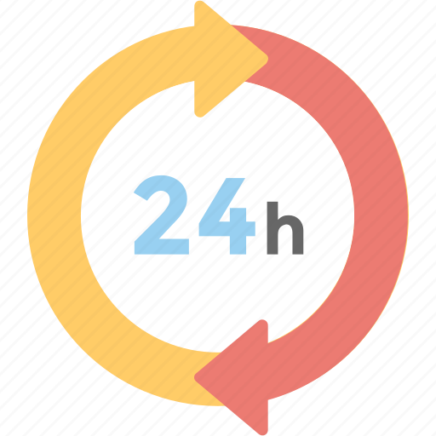
24-HOUR FORECAST
04-11-2022 @ 1200 UTC
Department of Meteorology and Climate Science, KNUST

Slide 2
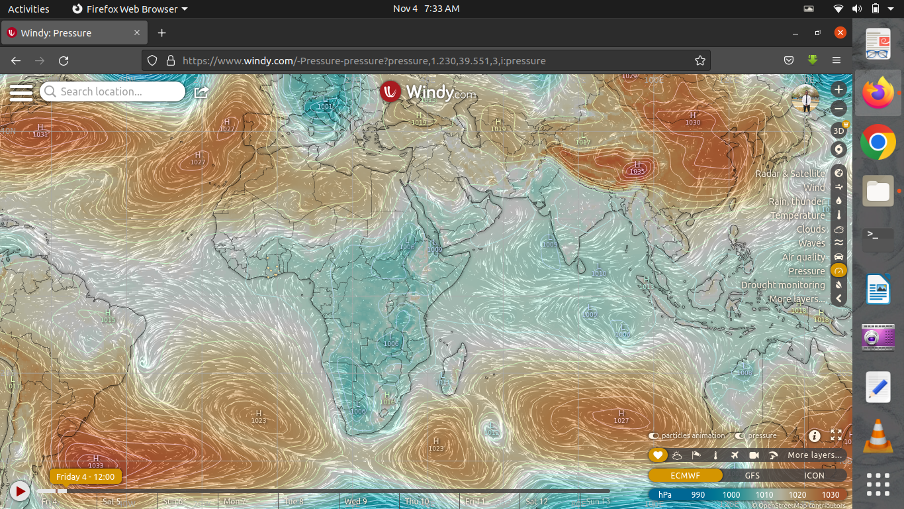
PRESSURE SYSTEM @ 1200 UTC
1027 hPa
1023 hPa

Slide 3
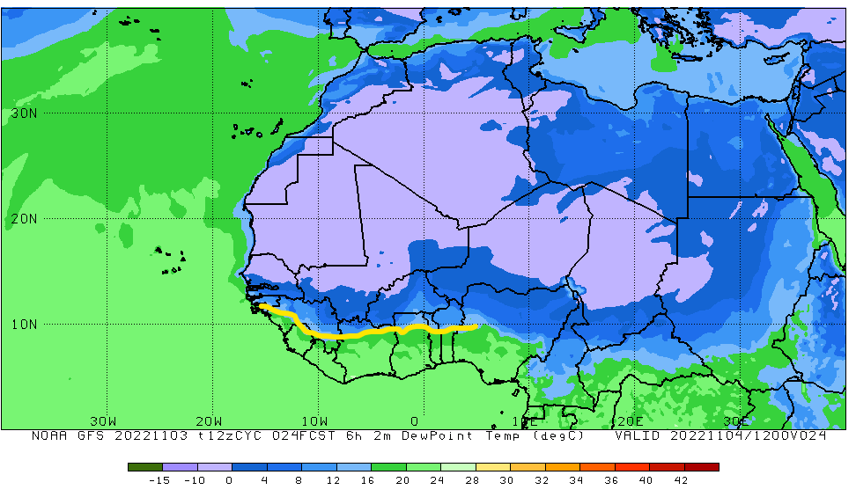
ITD POSITION @ 1200UTC
ITD: 9.8°N

Slide 4
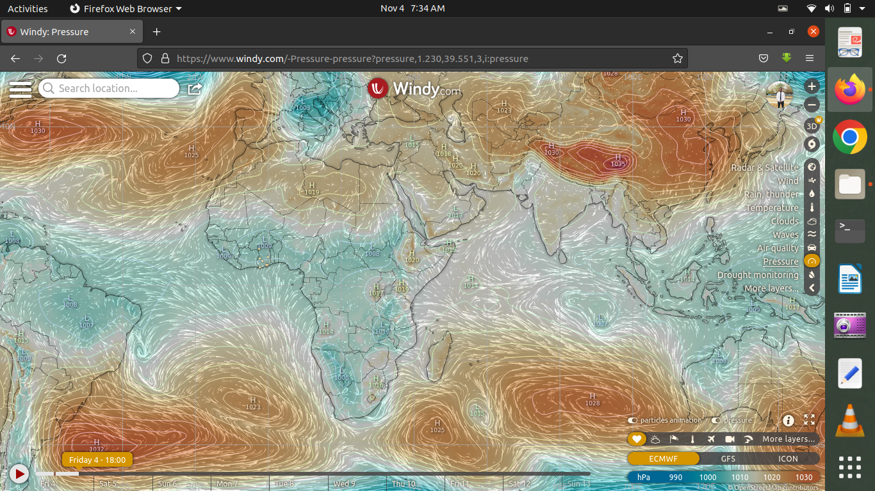
PRESSURE SYSTEM @ 1800 UTC
1025 hPa
1023 hPa

Slide 5
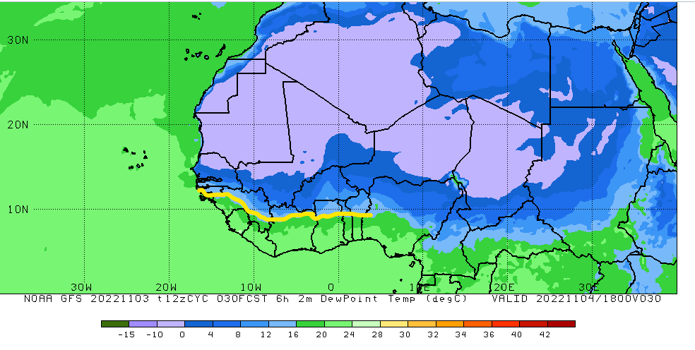
ITD POSITION @1800 UTC
ITD: 9.7°N

Slide 6
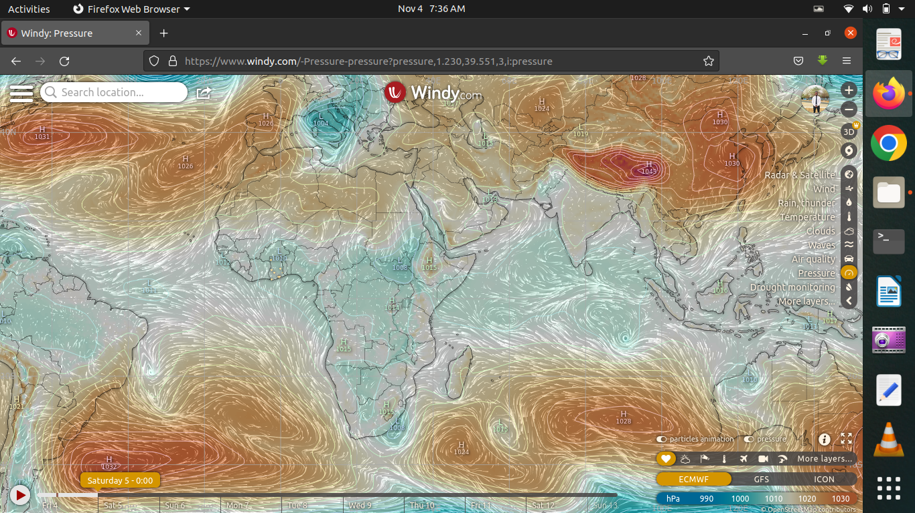
PRESSURE SYSTEM @ 0000 UTC
1026 hPa
1024 hPa

Slide 7
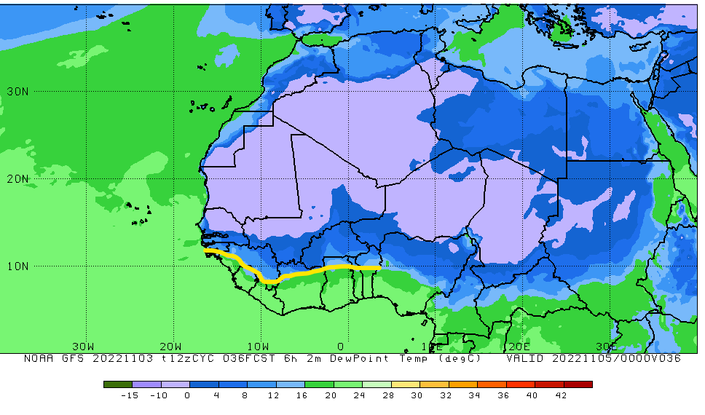
ITD POSITION @ 0000 UTC
ITD: 9.9°N

Slide 8
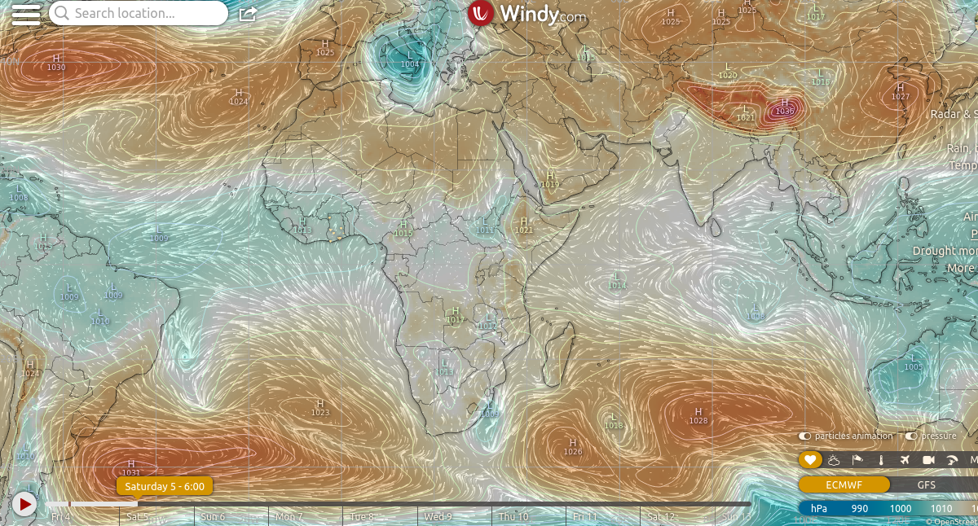
PRESSURE SYSTEM @ 0600 UTC
1024 hPa
1023 hPa

Slide 9
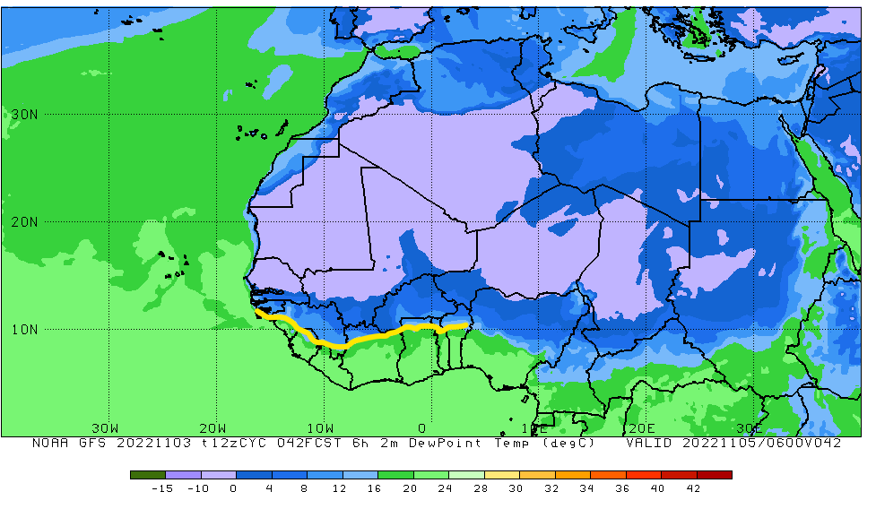
ITD POSITION @ 0600 UTC
ITD: 10.1°N

Slide 10
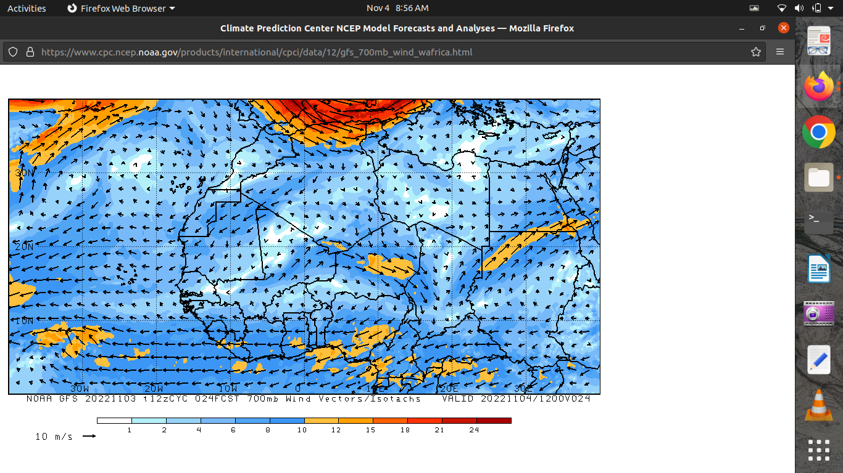
AEJ @ 1200 UTC

Slide 11
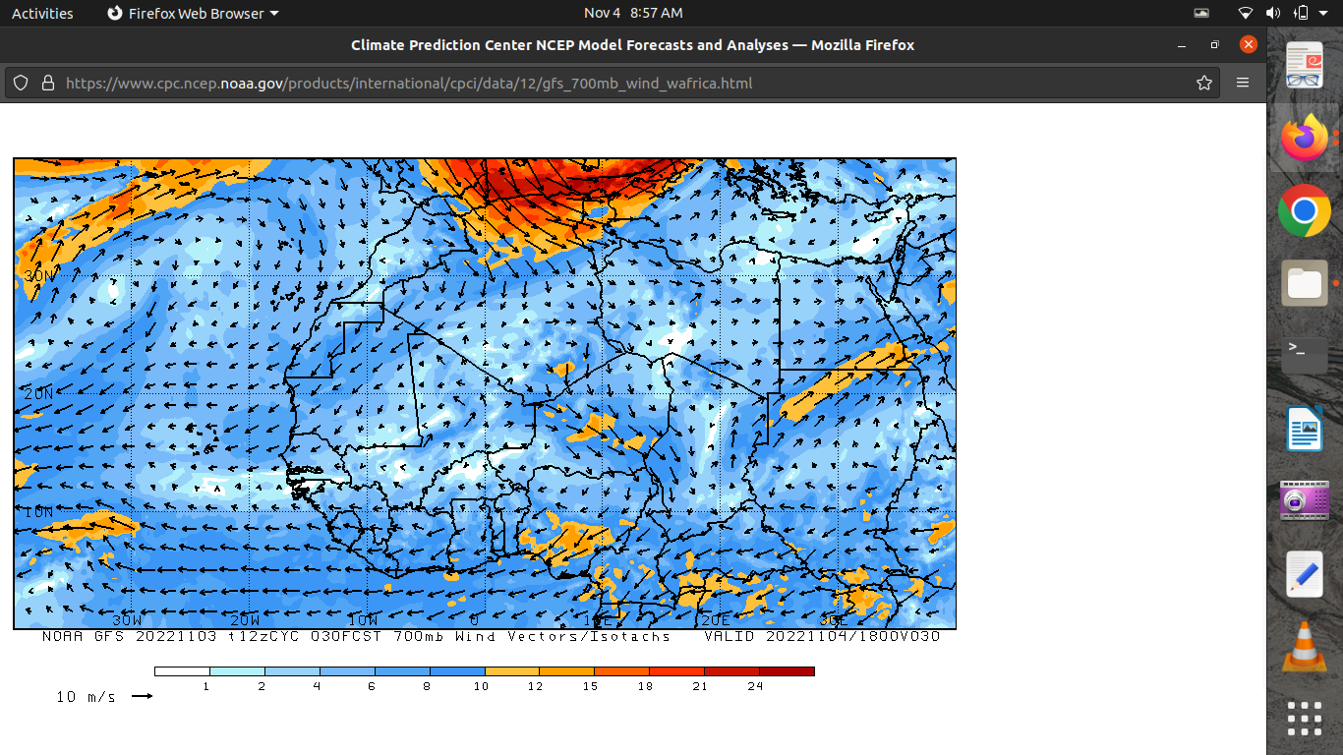
AEJ @ 1800 UTC

Slide 12
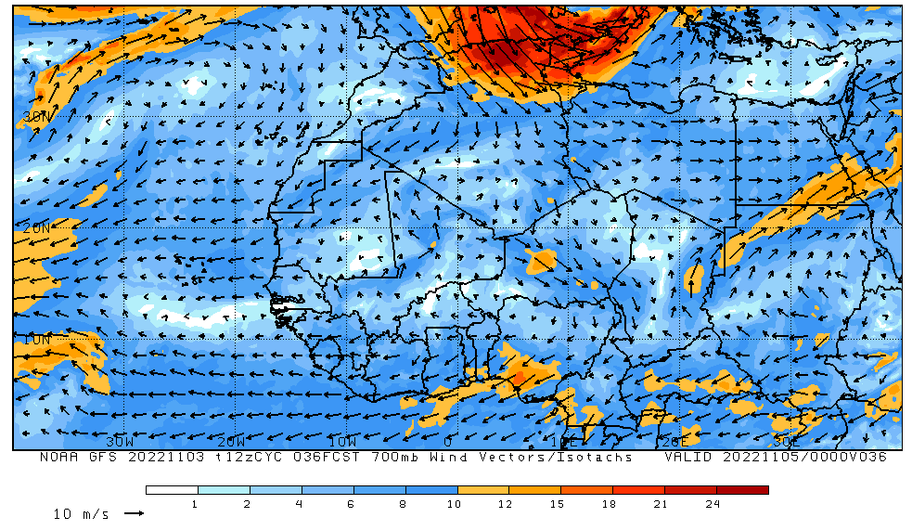
AEJ @ 0000 UTC

Slide 13
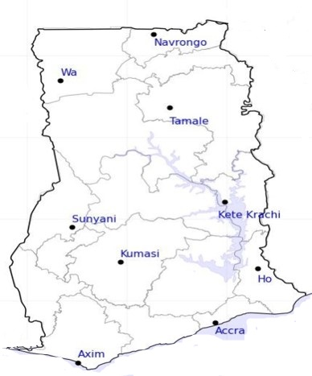
DAY
CAPE
[ J/kg ]
NIGHT
0
0
5
0
296
230
265
4
Damango
Damango
1868
2554
979
716
1014
1092
1212
1516
1358
1454
813
837

Slide 14
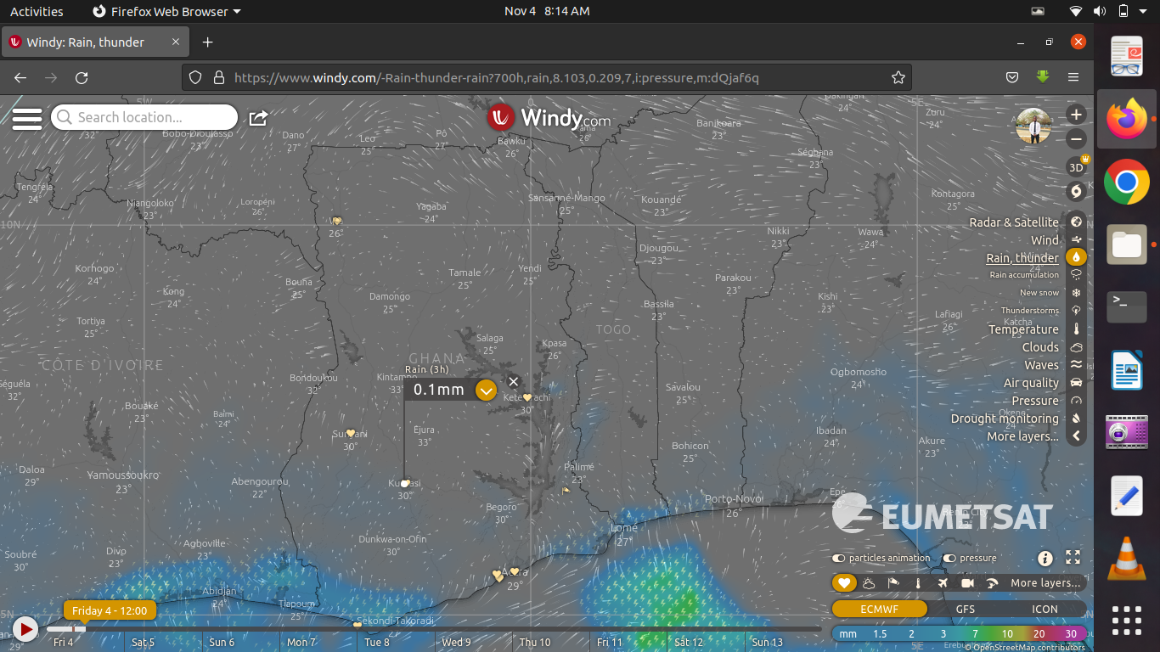
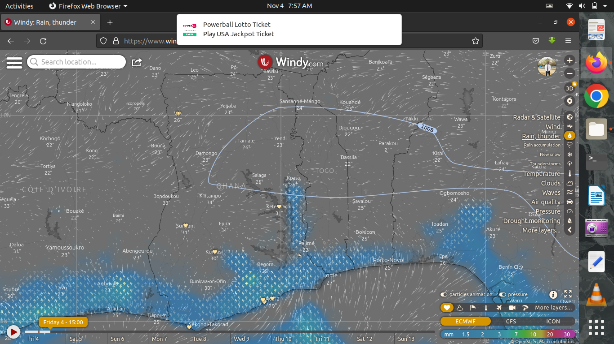
RAIN AND THUNDER
@ 1200 UTC
@ 1500 UTC

Slide 15
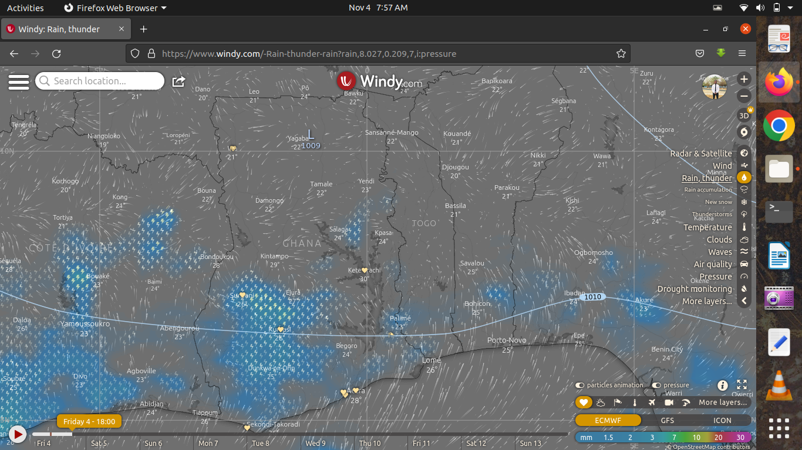
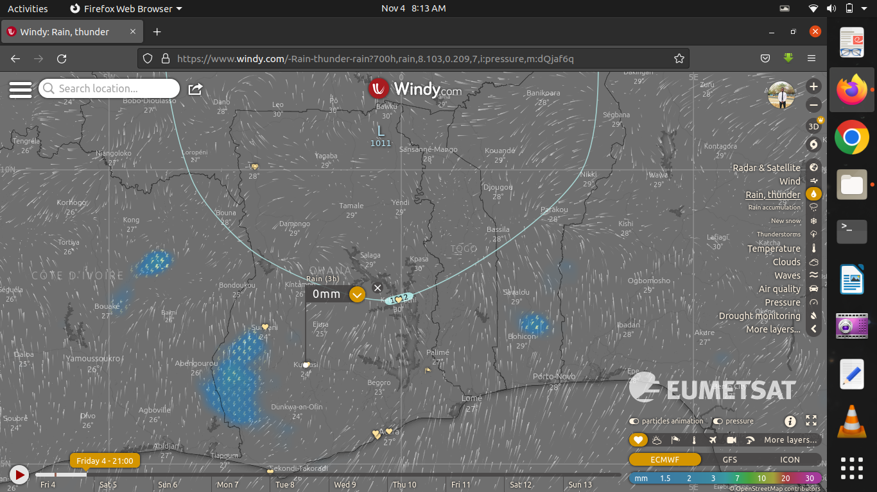
RAIN AND THUNDER
@ 1800 UTC
@ 2100 UTC

Slide 16
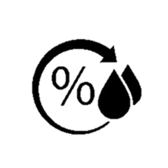
42
24-HOUR FORECAST
04-11-2022 @ 1200 UTC
46
RH AT DAY[%]
55
57
57
53
76
76
82
84

Slide 17
24-HOUR FORECAST
04-11-2022 @ 1200 UTC
54
53
65
RH AT NIGHT
[%]
56
56
55
93
94
88
90

Slide 18
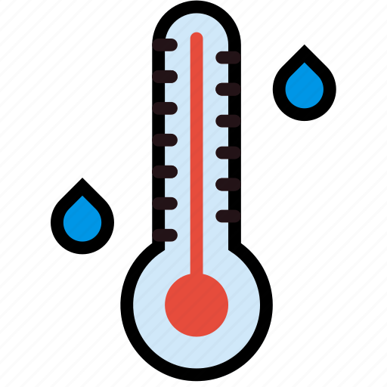
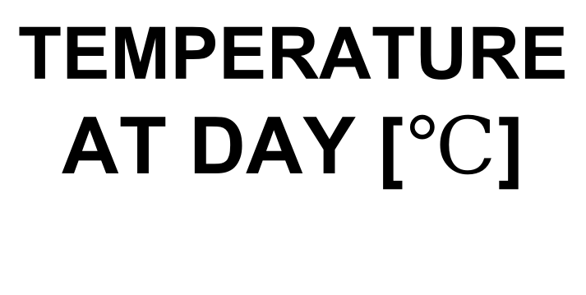
35
24-HOUR FORECAST
04-11-2022 @ 1200 UTC
34
TEMPERATURE AT DAY [$℃$]
33
35
31
31
29
30
28
27

Slide 19
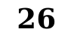
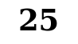
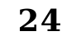

27
24-HOUR FORECAST
04-11-2022 @ 1200 UTC
26
28
TEMPERATURE AT NIGHT[$℃$]
$$26$$
29
24
25
$$24$$
26
$$25$$

Slide 20

GENERAL OUTLOOK
24-HOUR FORECAST
04-11-2022 @ 1200 UTC
PROBABILITY OF RAINS
30-60%

Slide 21

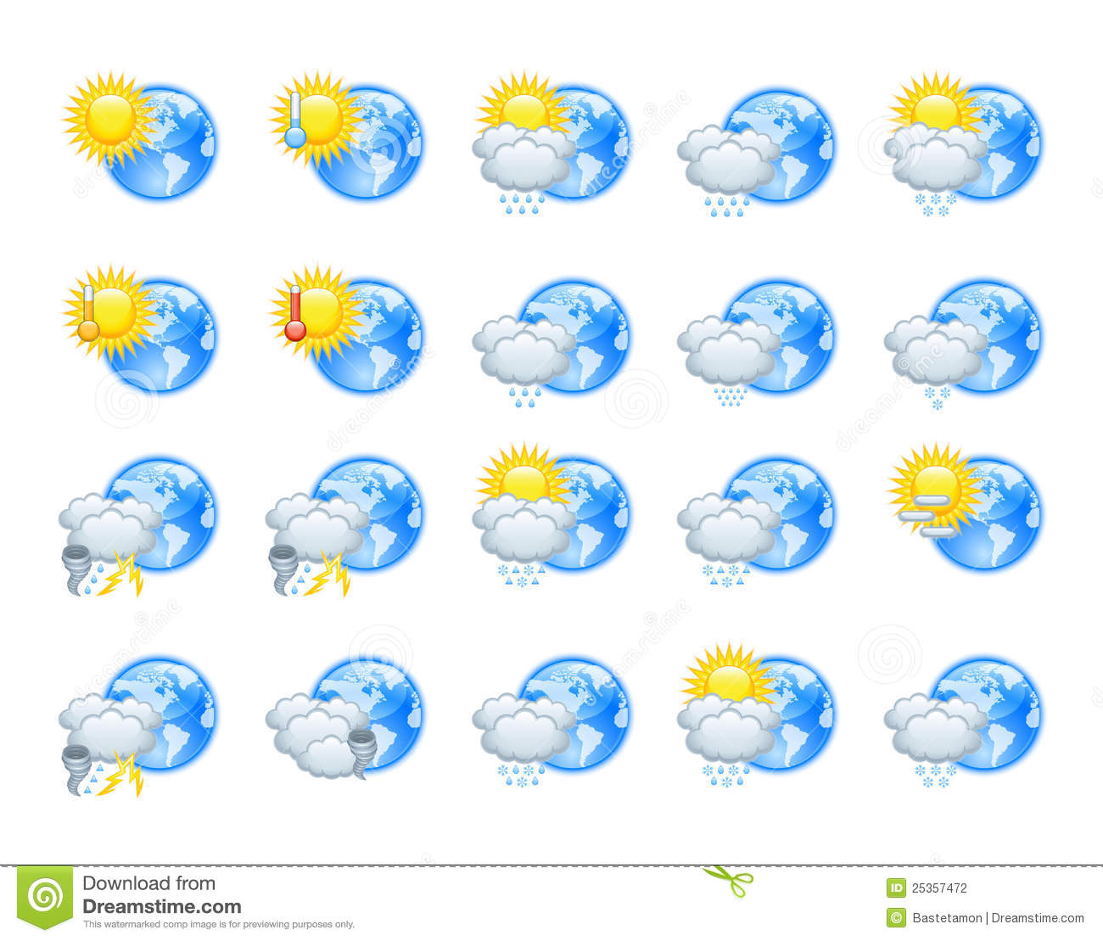





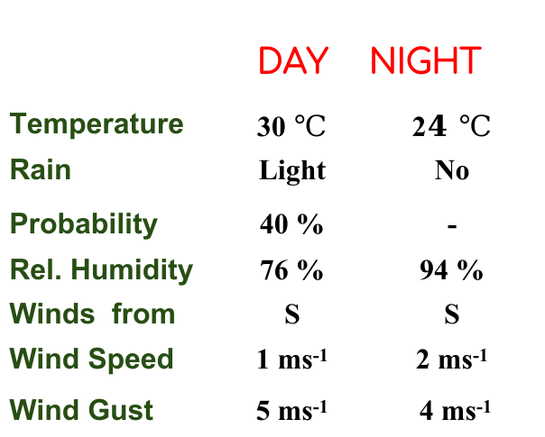
Department of Meteorology and Climate Science, KNUST
24-HOUR FORECAST
04-11-2022 @ 1200 UTC
Rain
Wind
Dust
Forecast Summary (KUMASI)
 | DAY | NIGHT
Temperature | 30 $℃$ | 2$4 ℃$
Rain | Light | No
Probability | 40 % | -
Rel. Humidity | 76 % | 94 %
Winds from | S | S
Wind Speed | 1 ms⁻¹ | 2 ms⁻¹
Wind Gust | 5 ms⁻¹ | 4 ms⁻¹
Low risk
Be aware
Be Prepared
Take Action
SUNSET: 05:46 PM SUNRISE: 05:54 AM

Slide 22


